Slide 1
Gold price analysis and prediction
The study includes illustrating trends and pattern, predicting gold prices, Back tested trading strategies, Market sentiment analysis, Statistical analysis on gold movements
Sushmitha R

Slide 2
Contents
Introduction
Objectives
Data description
Data preparation
Analysis
Time series decomposition
Predictive models
Testing strategy
Market sentiment analysis
Statistical analysis

Slide 3

Introduction
This presentation caters to the task2 “Project1” “Gold Price prediction and analysis” of Mentorness internship.
This project belongs to the domain “Finance”.
Objectives
Time series analysis to understand the trends and patterns
To build predictive models
To create trading strategies and back test it
To perform market sentiment analysis
To conduct statistical tests.

Slide 4
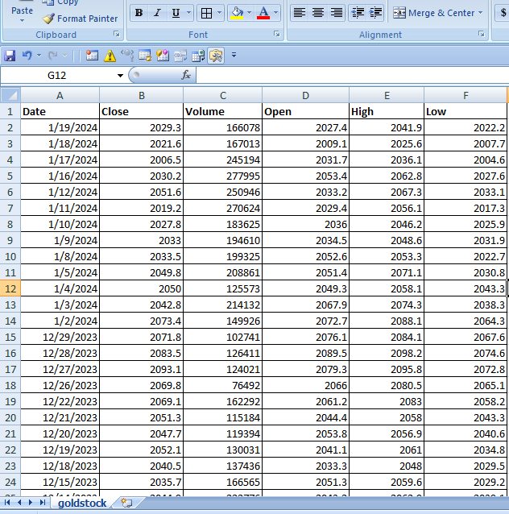
Data description
The data given is prices of the gold from January 19 2014 - January 22 2024(Stock market data).
The data has 6 features
Open price - The recorded opening price on each days
Close price - The recorded closing price on each day
High - The maximum price of each day
Low - The minimum price of each day
Volume - The size of the buyers and sellers on each day
Date - From (19th jan 2014 to 22nd jan 2024)
(10 years of data)
The macro economical data is taken from
Market trends website for sentiment analysis
And statistical analysis.
Inflation rate
GDP
S&p 500 Stock index data

Slide 5
Data preparation
Null values = No nulls
Outliers = None in 4 variables nd in volume we have outliers
To treat outliers we will using z core method.
As the data is not in order, its always good to work with chronological order so sort it (2014-2024)
When working with time series data, I did make sure the date column is the index

Slide 6
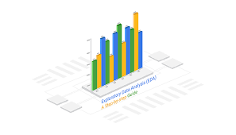
Exploratory data analysis -Distribution, Visualizations

Slide 7
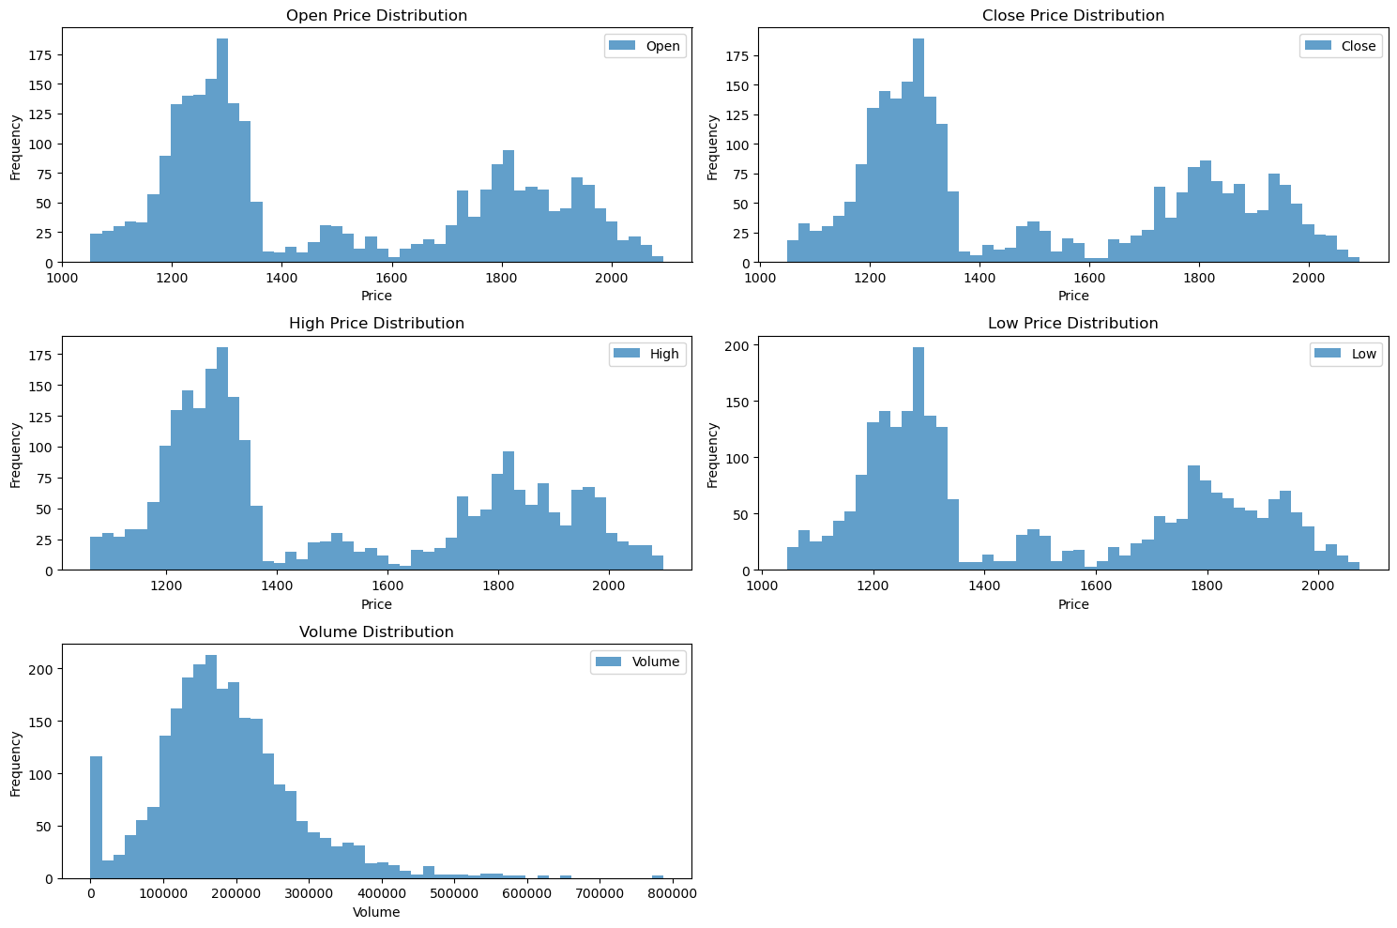
Data Distribution
Open,Close,High and Low follows- binomial distribution.
Volume follows right skewed distibution

Slide 8
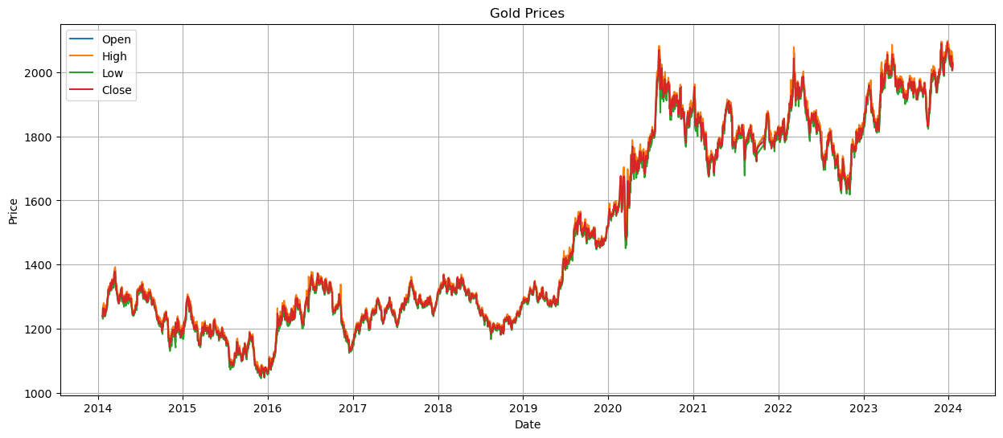
Visualization of gold price over time
This illustrates that all 4 features are in same scale so no need to do any scaling.
Also tell that they are correlated to each other because the graph falls in the same range without much fluctuations between the variables.

Slide 9
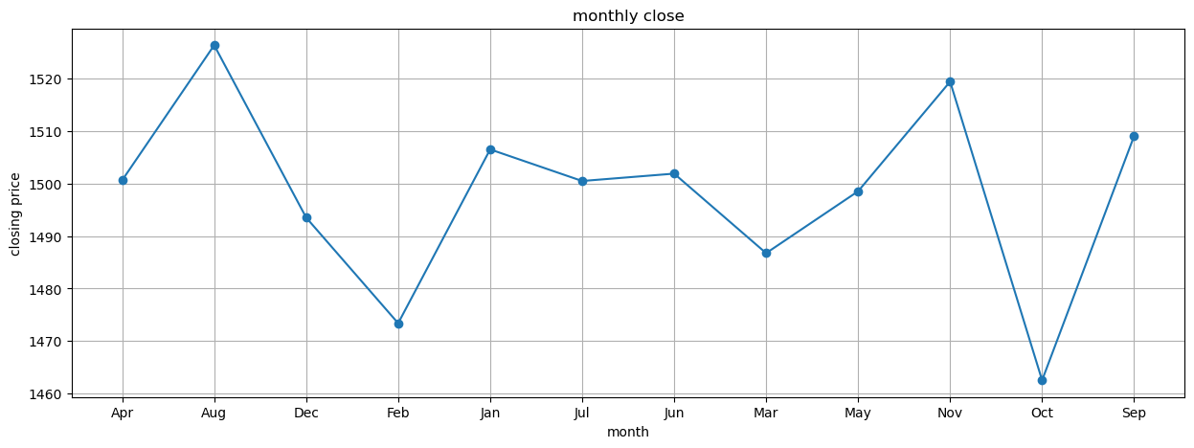
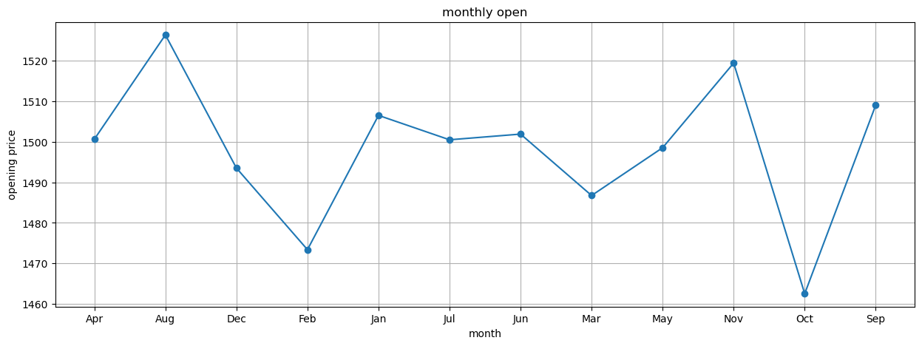
Open v/s close (Monthly)

Slide 10
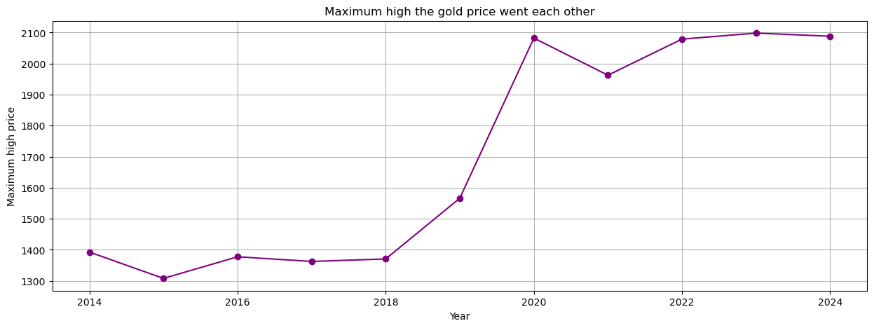
Maximum high (yearly)
Over 10 years the price skyrocketed in 2020 and the price being 2100 approx and maintaining the stability from then.

Slide 11
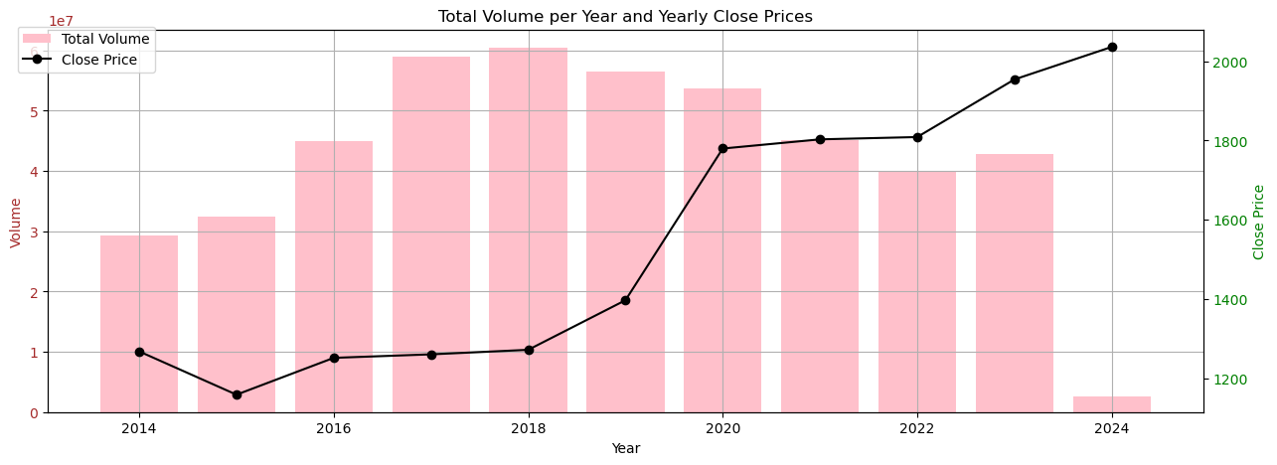
Volume v/s close price
When comparing the volume with the close price. There exists a pattern if the volume increases the price also increases. This also refers to the fact that during the pandemic the prices soared high and the volume of traders has increased. They influence each other quiet well.

Slide 12
Time series decomposition - Trend, Seasonality, Random fluctuations

Slide 13
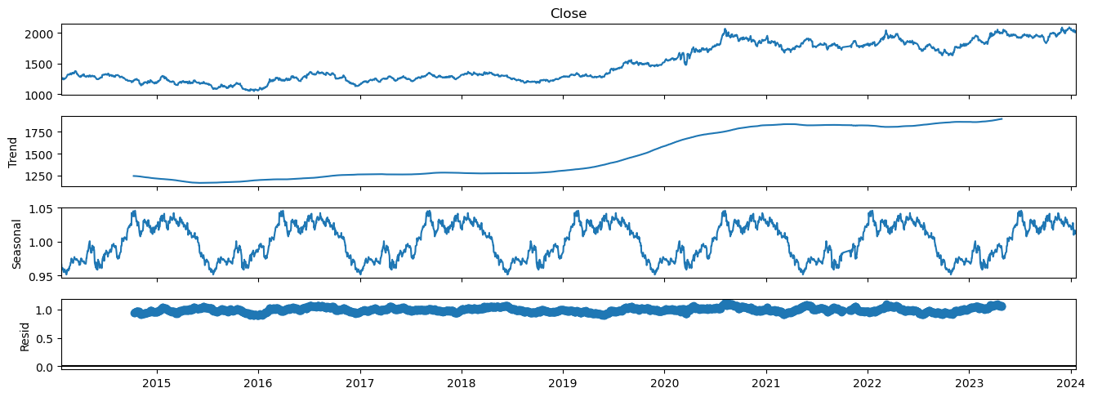
Time series Decomposition
This decomposition says that there exists a upward trend in gold prices and definitely seasonal component is there. As this is a stock data definitely random fluctuations will take place and its evident in this graph.

Slide 14
Predictive modelling - Vector auto regressive - Random forest classifier

Slide 15
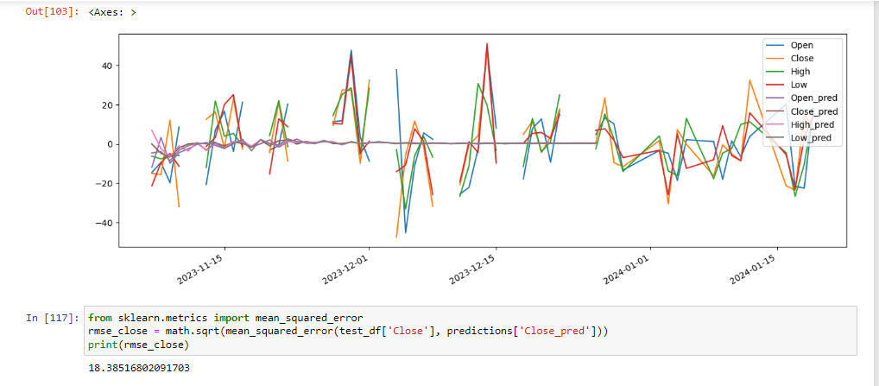
Vector auto regressive

Slide 16
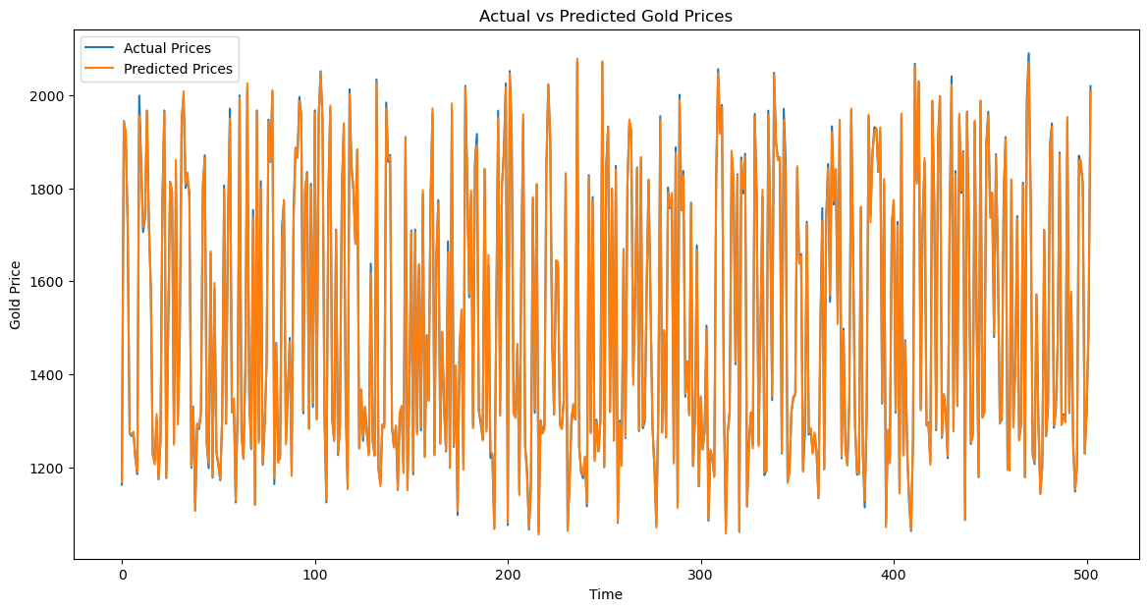
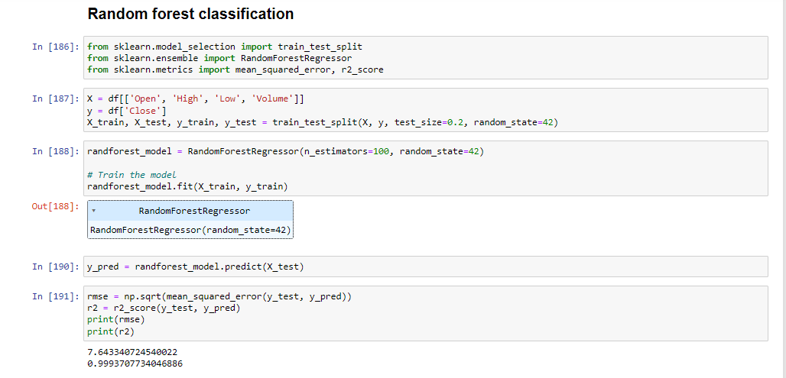
Random forest classifier

Slide 17
Trading strategy -Backtest strategy, Reverse strategy

Slide 18
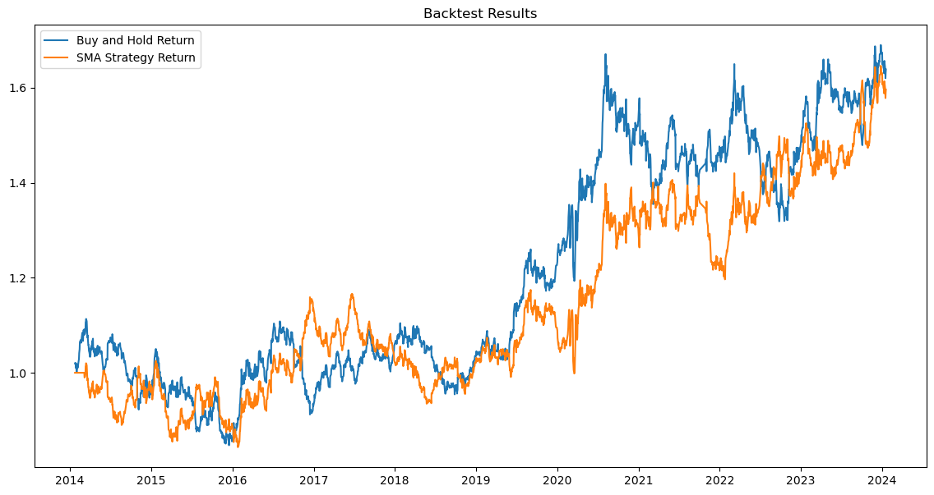
Backtest trading strategy
Strategy used: Simple Moving average strategy and Buy and hold return strategy.
This involves using 2 moving averages in order to generate buy & sell signals.

Slide 19
Market sentiment analysis -Impact of market events on gold prices

Slide 20
Market events
'2016-06-24', 'event': 'Brexit Referendum'
'2020-03-11', 'event': 'WHO Declares COVID-19 a Pandemic'
'2016-06-24', 'headline': 'Trump election victory boosts gold prices'
'2020-08-07', 'headline': 'Gold Prices Hit All-Time High Amidst Pandemic Uncertainty'
'2020-11-03', 'headline': 'Bidens Presidential Election Win and Impact on Gold Prices'
'2021-01-06', 'headline': 'Capitol Riots and Political Unrest Drive Gold Prices Higher'
'2022-02-24', 'headline': 'Russia Invades Ukraine, Gold Prices Spike'
'2015-12-16', 'headline': 'Gold Prices Drop as Fed Raises Interest Rates for First Time Since 2006‘
'2019-06-23', 'headline': 'US-China Trade War Tensions Push Gold Prices Higher'
'2019-08-23', 'headline': 'Global Recession Fears Drive Gold Prices Up'

Slide 21
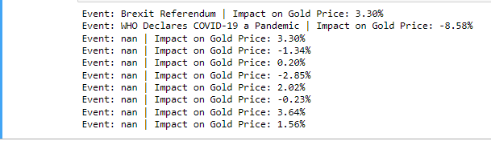
Events impact on Gold prices

Slide 22
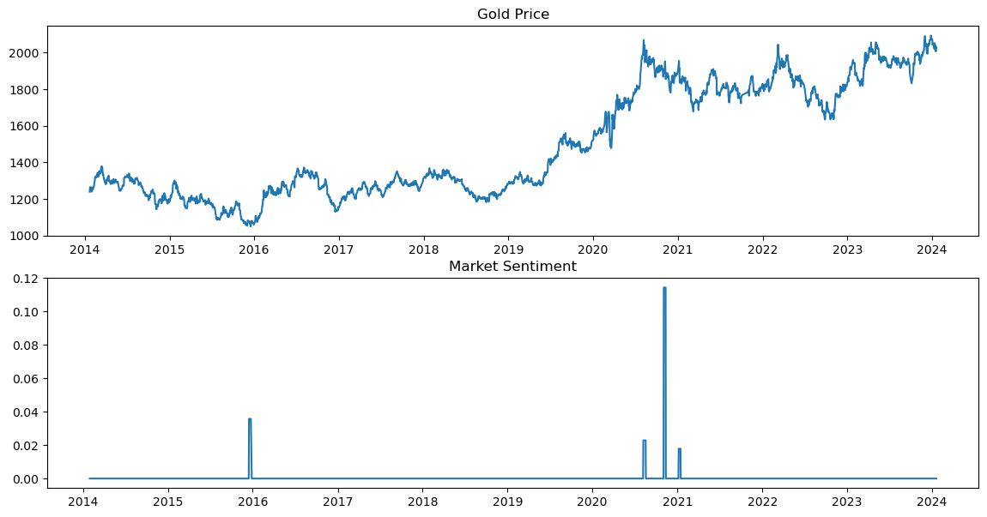
Sentiment analysis
The spike in market sentiment around mid-2016 does not seem to have a long-term effect on the gold. The spike in early 2021 corresponds to the peak in gold prices. This could indicate a strong correlation where increased market sentiment drives up gold prices or vice versa.

Slide 23
Statistical analysis - Volatility - Correlation with external factors - Macro economical factors and its influence on gold

Slide 24
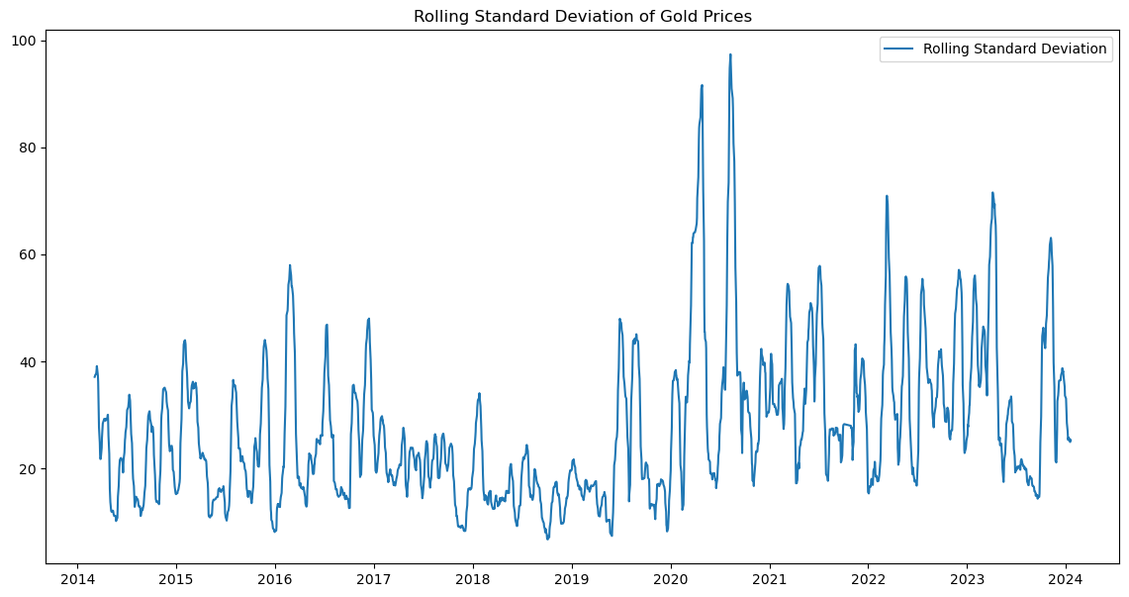
Volatility
One way to measure volatility is by calculating the rolling standard deviation. Here the graph shows high volatilty during 2020 indicating the gold is experiencing larger changes. Later the price was stabilized showing low volatility. This can make it difficult to predict and considered as risky investment

Slide 25
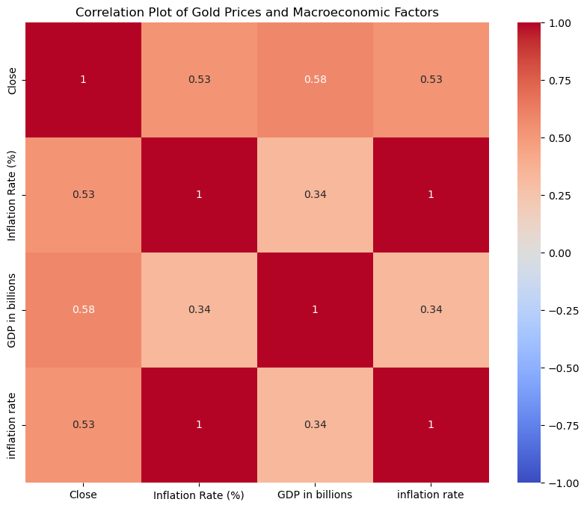
Macro economical factors v/s gold price
The correlation matrix explains how far the independent variables are influencing the dependent variable which is “Closing price”. From this graph it tells both inflation rate and GDP plays equal role. But these factors alone are not responsible for any changes in the gold price over a period of 10 years.

Slide 26
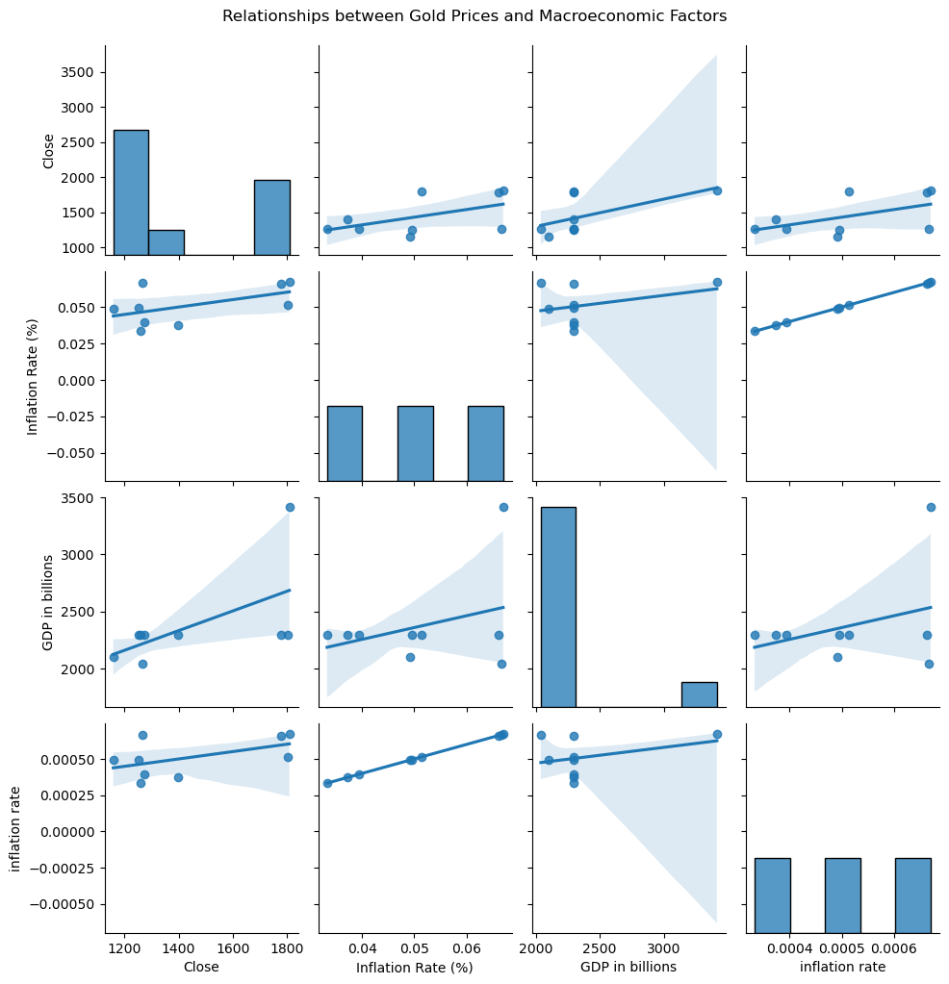
Relationships between gold and macro economic factors
The positive correlation between gold prices and inflation rates. The positive relationship between gold prices and GDP indicates that gold prices may increase as the economy grows. The positive correlation suggests that higher GDP is associated with higher inflation rates, which is typical in growing economies

Slide 27
Conclusion
The best predictive model is Random forest classifier with high accuracy.
The best strategy to use is Buy and hold strategy return.
Event “Capitol riots and political unrest has a great impact on gold prices
Positive correlation among inflation, GDP and the gold prices over 10 years.

